Slide 1
Vibrational relaxation
E
S₂
T₂
S₁
T₁
always radiationless (”dark”)
typically to vibrational ground state
S₀

Slide 2
Singlet state deactivation channels
Let us excite first…
E
S₂
T₂
S₁
the excited state typically relaxes
T₁
S₀

Slide 3
Fluorescence: spin conserving emission
E
S₂
T₂
S₁
T₁
from the vibrational ground state to several vibrational states
S₀

Slide 4
Internal conversion (IC)
E
IC
S₂
T₂
IC
S₁
T₁
spin conservation
S₀

Slide 5
Intersystem crossing (ISC)
E
S₂
T₂
ISC
S₁
ISC
T₁
spin change
S₀

Slide 6
Phosphorescence: emission with spin change
E
S₂
T₂
S₁
T₁
from the vibrational ground state to several vibrational states
S₀

Slide 7
ISC & phosphorescence: potential energy curves
absorption & relaxation
ISC: S₁ → T₁
relaxation
phosphorescence: T₁ → S₀
InterSystem Crossing: transition at the crossing of S₁ and T₁
adapted from Keszei 2006

Slide 8
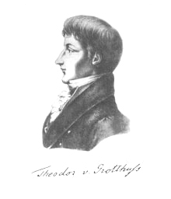
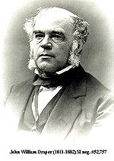
Photochemistry
(1) The first law of photochemistry:
Grotthuss and Draper, 1818:
light must be absorbed by a chemical substance in order to initiate a photochemical reaction.

Slide 9
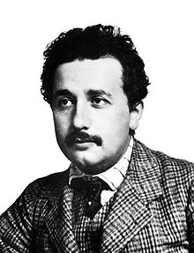
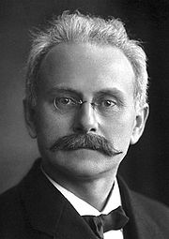
(2) The second law of photochemistry / The law of photochemical equivalence
Einstein and Stark, 1912
One quantum of radiation absorbed by a molecule activates one molecule in the primary step of photochemical process.
A chemical reaction wherein the photon is one of the reactant.
S + hγ → S*
The activation of any molecule or atom is induced by the absorption of single light quantum.
μ = Lhγ = 0.1196 ν J mol⁻¹
one einstein

Slide 10
absorption of multiple photons
Under high intensive radiation, absorption of multi-proton may occur.
A + hγ → A*
A* + hγ → A**
Under ultra-high intensive radiation, SiF₆ can absorb 20~ 40 protons.
These multi-proton absorption occur only at I = 10²⁶ photon s⁻¹ cm⁻³, life-time of the photoexcited species > 10⁻⁸ s.
Commonly, I = 10¹³ ~ 10¹⁸ photon s⁻¹ cm⁻³, life-time of A* < 10⁻⁸ s. The probability of multi-photon absorption is rare.

